Slide 1
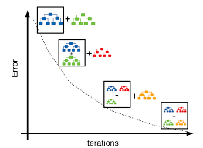
XG Boost
Gradient boosting Regression calculates the difference between the current prediction and the known correct target value. This difference is called residual. After that Gradient boosting Regression trains a weak model that maps features to that residual.

Slide 2
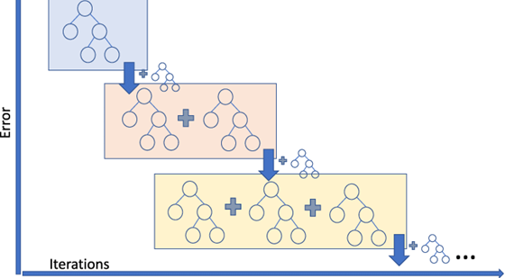

Slide 3
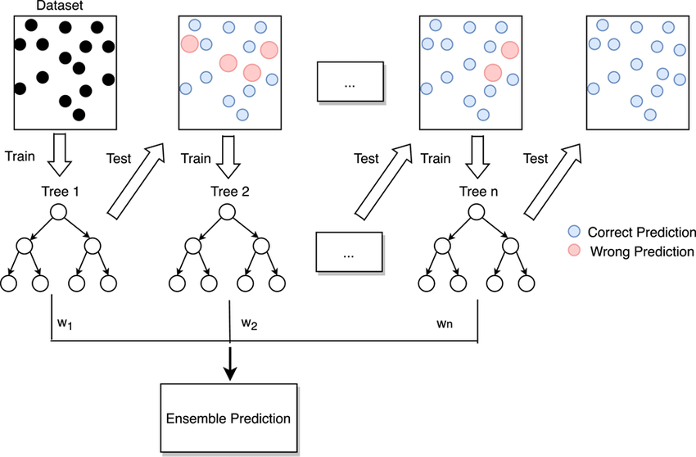

Slide 4
Install XGBoost by running the following command:
!pip install xgboost
Import the XGBoost regressor by adding the following line:
from xgboost import XGBRegressor
For reference : https://scikit-learn.org/stable/modules/generated/sklearn.ensemble.GradientBoostingRegressor.html#sklearn.ensemble.GradientBoostingRegressor

